Slide 1

Security, Authentication and Authorization
SQL Injection, XSS, CSRF, Authentication, Authorization
SoftUni Team
Technical Trainers
Software University
http://softuni.bg

Slide 2
Table of Contents
Security Fundamentals
Most common attacks
SQL Injection
XSS
CSRF
Parameter Tampering
Authentication & Authorization

Slide 3
Have a Question?
sli.do #csharp-web

Slide 4




Security Fundamentals
The concepts of Web Security

Slide 5





Security Fundamentals
Web Security encompasses measures to improve an app’s security
Often done by fixing and preventing security vulnerabilities
Vulnerabilities are ever-evolving but mostly – largely consistent
"One thing is considered secured, when breaking its security costs more than the value received by doing so…"

Slide 6


Security Fundamentals
Security Breaches often happen spontaneously
The vulnerability can be completely unintentional
Security Breaches are the result of malicious attacks
These attacks may have many motives backing them
Challenge / Prestige, Curiosity, Vandalizing, Stealing
Security Breaches can be completely discrete
Highly-experienced attackers will not leave any trace
You will most likely realize you were attacked a lot later

Slide 7
Security Fundamentals
There is a wide range of known types of threats and attacks
There is an even wider range of unknown threats and attacks…
Category | Threats / Attacks
Input Validation | Buffer overflow, cross-site scripting, SQL injection, canonicalization
Parameter Tampering | Query string manipulation, form field manipulation, cookie manipulation, HTTP header manipulation
Session Management | Session hijacking, session replay, man-in-the-middle
Cryptography | Poor key generation or key management, weak or custom encryption
Sensitive Information | Access sensitive code or data in storage, network eavesdropping, code/data tampering, Admin password in exceptions
Exception Management | Information disclosure, denial of service

Slide 8








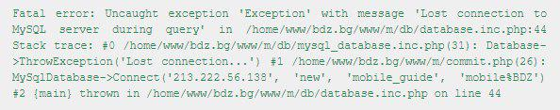
Security Fundamentals
Some of the best actions a developer can take to secure an app
Maximum Simplicity
Securing the Weakest Link
Limiting the Publicly Available Resources
Incorrect until proven Correct
The "Weakest Privilege" Principal
Security in Errors
Provide Constant defense
Dev

Slide 9
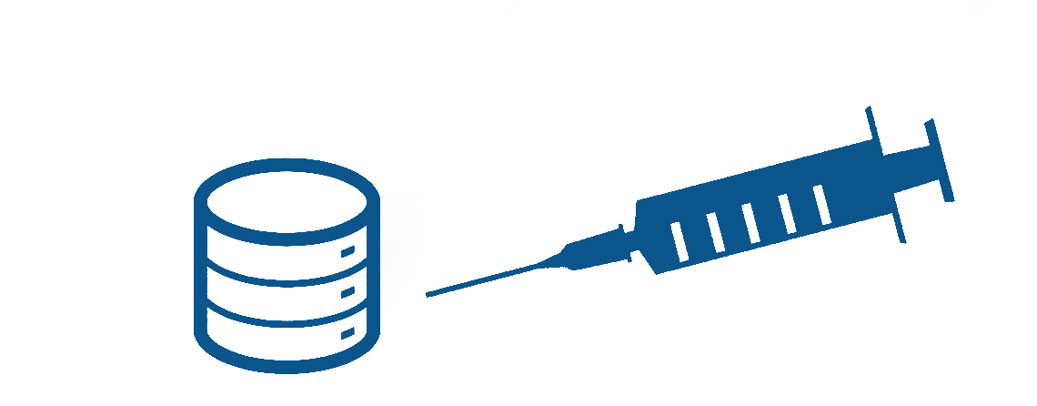
SQL Injection

Slide 10
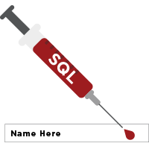
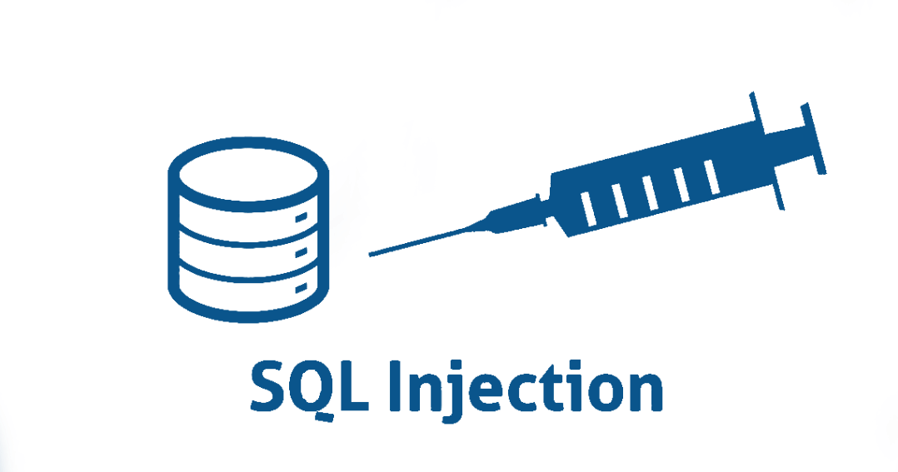
SQL Injection
The following SQL commands are executed:
Usual search (no SQL injection):
SQL-injected search (matches all records):
SQL-injected INSERT command:
SELECT * FROM Messages WHERE MessageText LIKE '%Nikolay.IT%'"
SELECT * FROM Messages WHERE MessageText LIKE '%%%%'"
SELECT * FROM Messages WHERE MessageText LIKE '%' or 1=1 --%'"
SELECT * FROM Messages WHERE MessageText
LIKE '%'; INSERT INTO Messages(MessageText, MessageDate) VALUES ('Hacked!!!', '1.1.1980') --%'"

Slide 11
SQL Injection
Original SQL Query:
Setting username to John & password to ' OR '1'= '1 produces
The result:
The user with username – "Admin" will login WITHOUT password
The pass query will turn into an bool expression which is always true
string sqlQuery = "SELECT * FROM user WHERE name = '" + username + "' AND pass='" + password + "'";
string sqlQuery = "SELECT * FROM user WHERE name = 'Admin' AND pass='' OR '1'='1‘"

Slide 12
XSS
Cross Site Scripting (XSS)

Slide 13

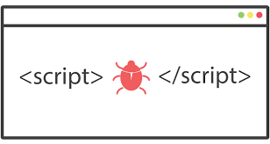
XSS
Cross-site scripting (XSS) is a common vulnerability in Web apps
Web applications display a JavaScript code
Executed at the client's browser
Crackers could take control over sessions, cookies, passwords, etc.
How to prevent from XSS?
Validate the user input (built-in in ASP.NET Core)
Perform HTML escaping when displaying text data

Slide 14




XSS
Cross-site scripting attack
Cookie theft
Account hijacking
Modify content
Modify user settings
Download malware
Submit CRSF attack
Password prompt
Execute the script on visiting the page
Submits script on an unsafe form

Slide 15
CSRF
Cross-Site Request Forgery

Slide 16
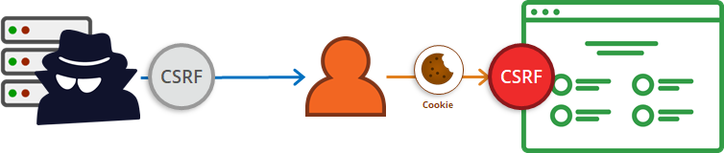
Cross-Site Request Forgery
It is a web security attack over the HTTP protocol
Allows executing unauthorized commands on behalf of some user
The user has valid permissions to execute the requested command
The attacker uses these permissions maliciously, unbeknownst to the user

Slide 17
Cross-Site Request Forgery
The process is not that complex to comprehend:
The user has an valid auth cookie for the site victim.org
This is stored in the browser
The attacker asks the user to visit http://evilsite.com
The attacker takes the stored cookie
The evil site sends HTTP Request to victim.org using the cookie
The victim.org performs actions on behalf of the user
After all, the actions is done using the user’s credentials

Slide 18
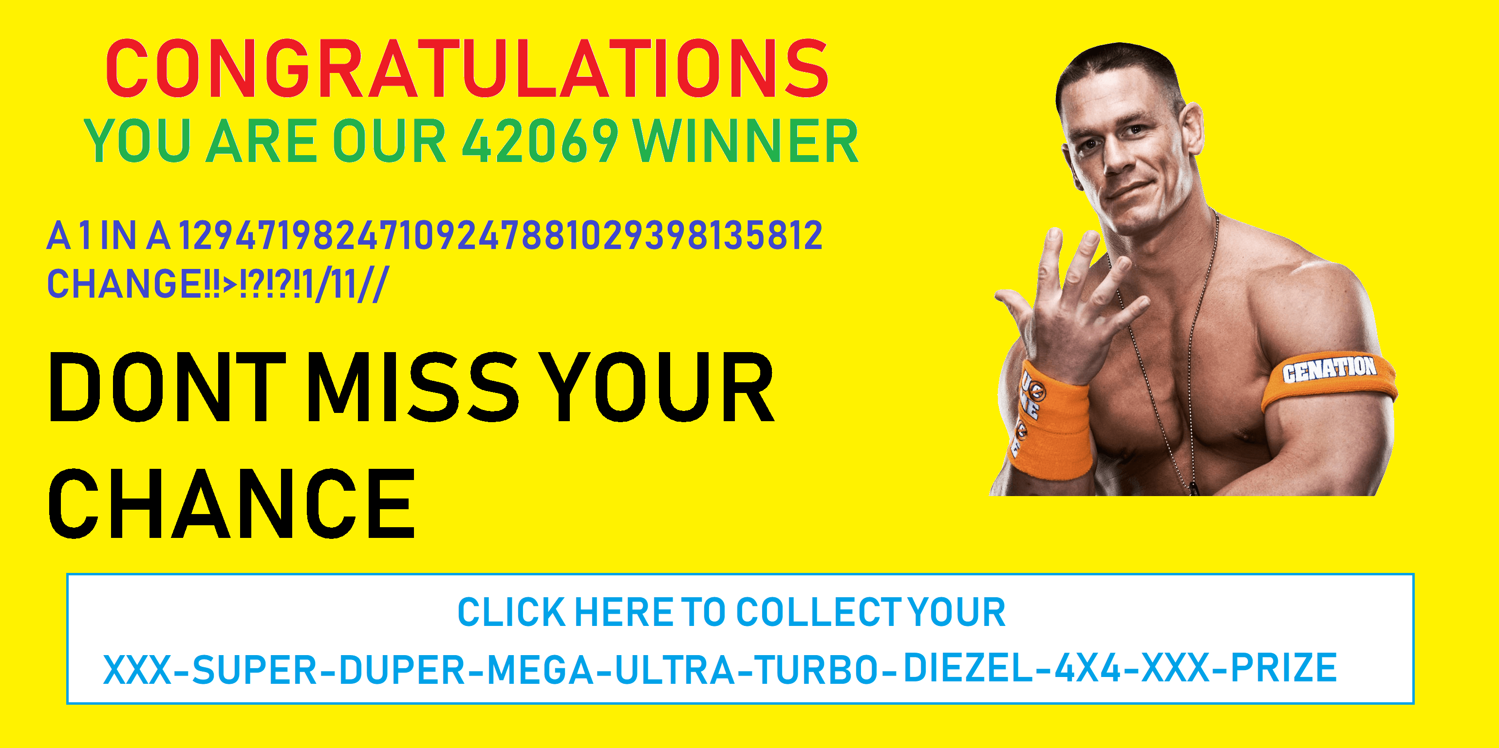
Cross-Site Request Forgery
What Cross-Site Request Forgery usually looks like:

Slide 19

Cross-Site Request Forgery
What Cross-Site Request Forgery actually is:
The user can even misclick the button accidentally
This will still trigger the attack
Security against such attacks is necessary
It protects both your app and your clients
<!-- SOME MULTI-COLOR USELESS CLICKBAIT CONTENT --> <form action="http://good-banking-site.com/api/account" method="post">
<input type="hidden" name="Transaction" value="withdraw">
<input type="hidden" name="Amount" value="1000000">
<input type="submit" value="Click to collect your prize!">
</form>

Slide 20
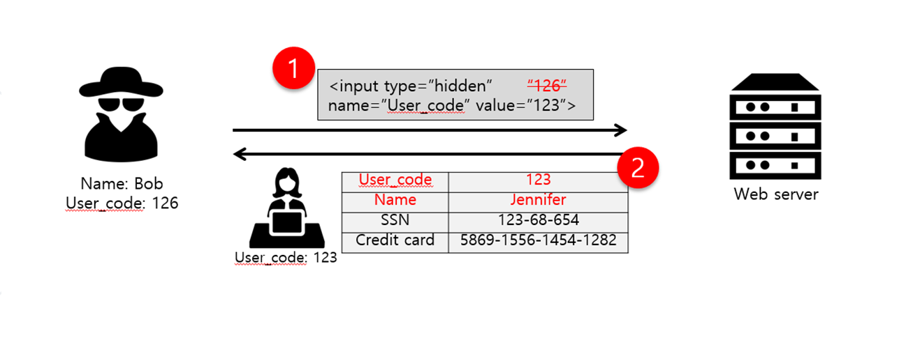
Parameter Tampering

Slide 21
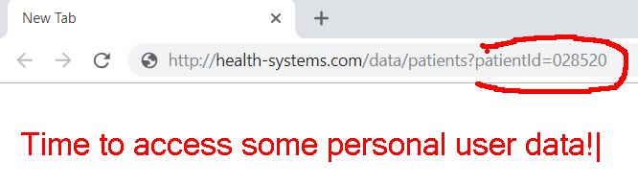
Parameter Tampering
Parameter Tampering is the manipulation of parameters exchanged between client and server
Altered query strings, request bodies, cookies
Skipped data validations, Injected additional parameters

Slide 22
Other Security Threats
Semantic URL/HTTP attacks (URL/HTTP manipulation)
Always validate the data on the server-side
Man in the Middle (Always use SSL)
Insufficient Access Control
Other types of data injection (Always sanitize data)
DoS and DDoS and Brute Force attacks (CAPTCHA and Firewall)
Phishing and Social Engineering (Educate your users)
Security flows in other software we use (Use latest versions)

Slide 23
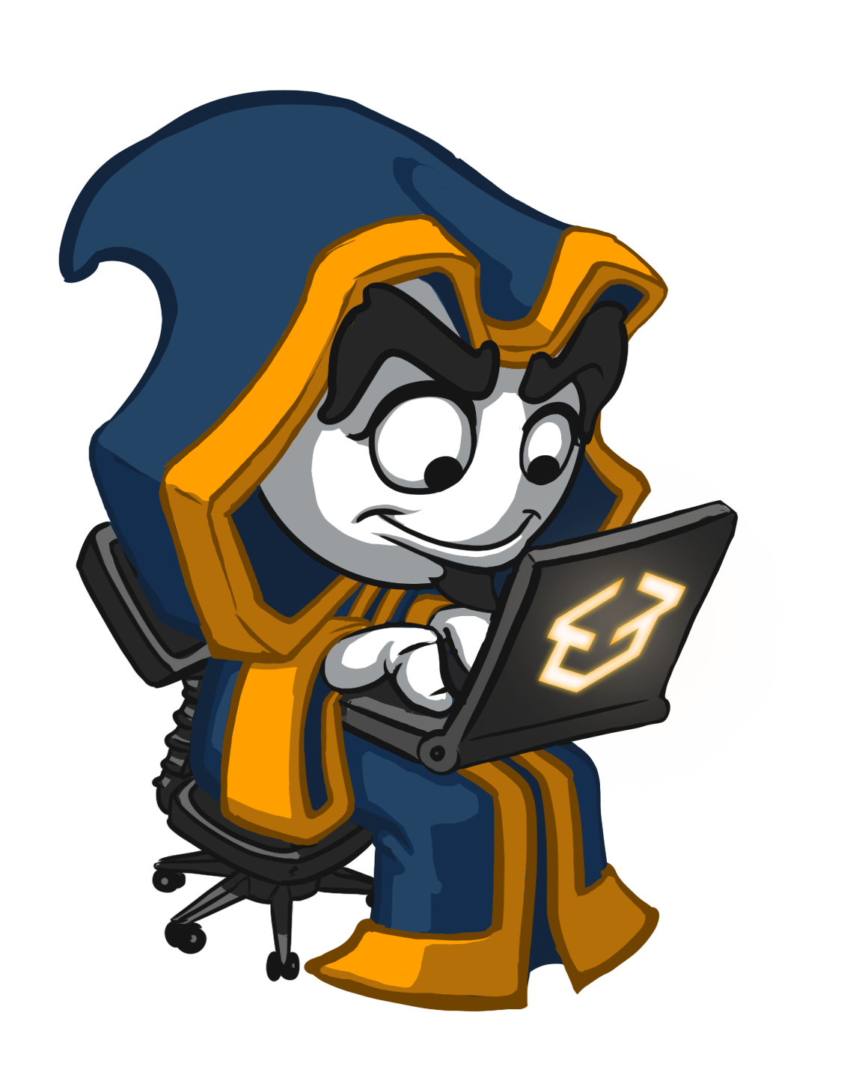
Security Fundamentals
Live Demo

Slide 24
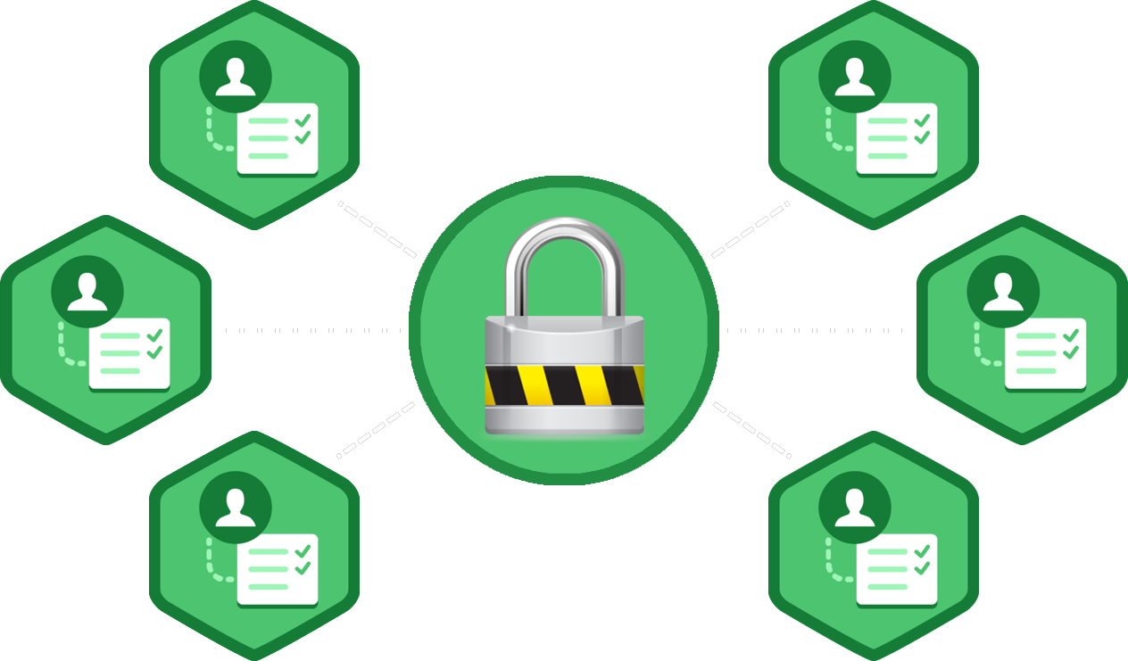
Authentication and Authorization
What's the Difference?

Slide 25
Authentication vs. Authorization
Authentication
The process of verifying the identity of a user or computer
Questions: Who are you? How you prove it?
Credentials can be password, smart card, external token, etc.
Authorization
The process of determining what a user is permitted to do on a computer or network
Questions: What are you allowed to do? Can you see this page?

Slide 26
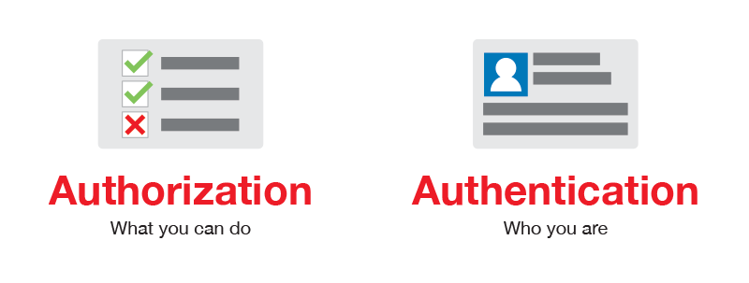
Authentication vs. Authorization

Slide 27
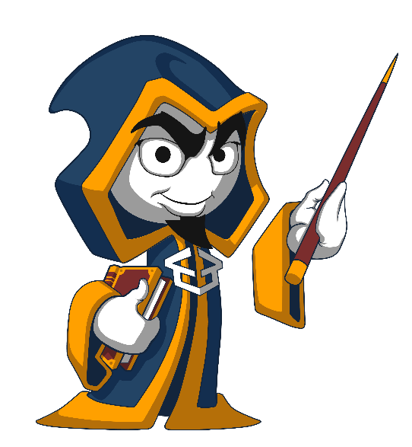
Summary
Security Fundamentals
What are the most important concepts?
Security attacks
SQL Injection
XSS
CSRF
Parameter Tampering
Other attacks
…
…
…

Slide 28
https://softuni.bg/trainings/courses

Slide 29










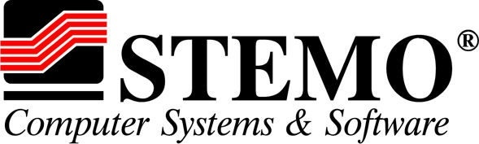

SoftUni Diamond Partners

Slide 30




SoftUni Organizational Partners

Slide 31




Trainings @ Software University (SoftUni)
Software University – High-Quality Education and Employment Opportunities
softuni.bg
Software University Foundation
http://softuni.foundation/
Software University @ Facebook
facebook.com/SoftwareUniversity
Software University Forums
forum.softuni.bg

Slide 32

License
This course (slides, examples, demos, videos, homework, etc.) is licensed under the "Creative Commons Attribution-NonCommercial-ShareAlike 4.0 International" license

